Slide 1
It’s not easy being (photosynthetic) green…

Slide 2
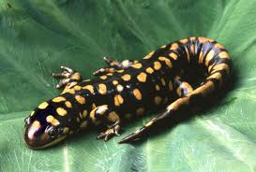

Slide 4
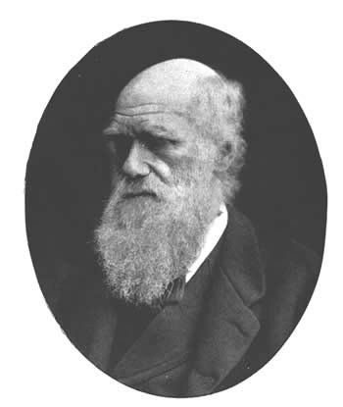
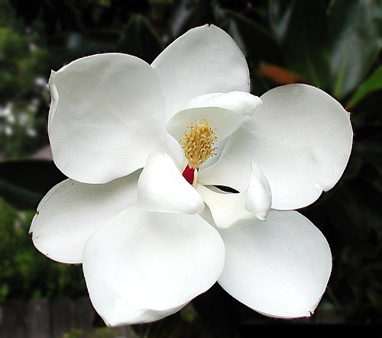
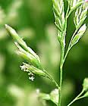
“…an abominable mystery…”
www.mrdowling.com
www.baruch.cuny.edu
http://patricianeelydorsey.webs.com
The origin and diversification of
Flowering Plants

Slide 5
Rafflesia arnoldi

Slide 6
Amorphophallus titanium

Slide 7
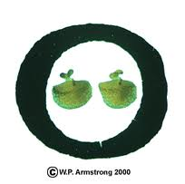
Wolffia

Slide 8
Hydnora africana

Slide 9
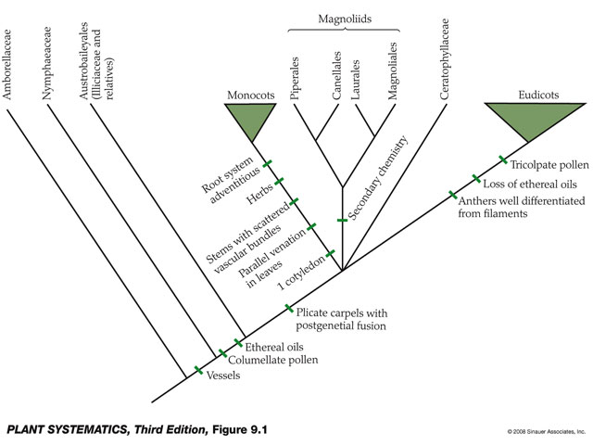

Slide 10
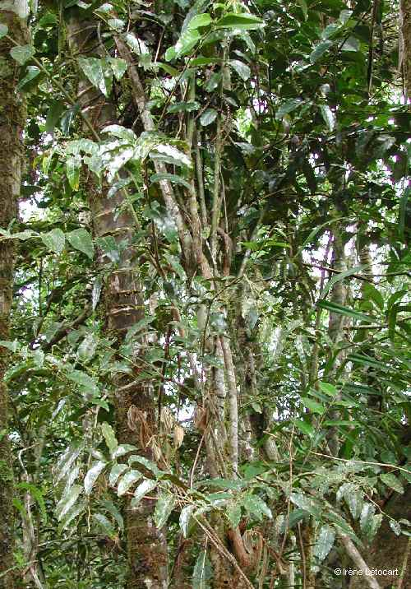
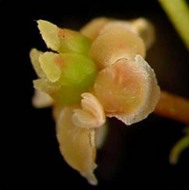
Amborella

Slide 11
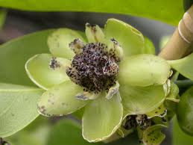
Austrobaileya

Slide 12
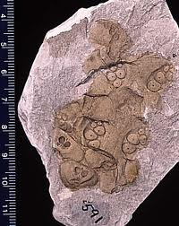
Nymphales

Slide 13
Illicium

Slide 15
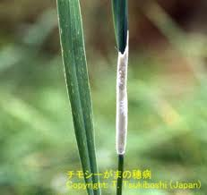
Monocots

Slide 17
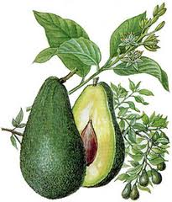
magnoliids

Slide 19
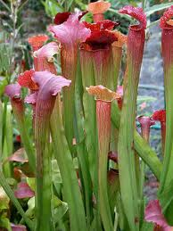
eudicots

Slide 20
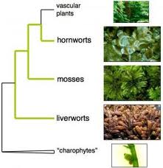

Slide 21
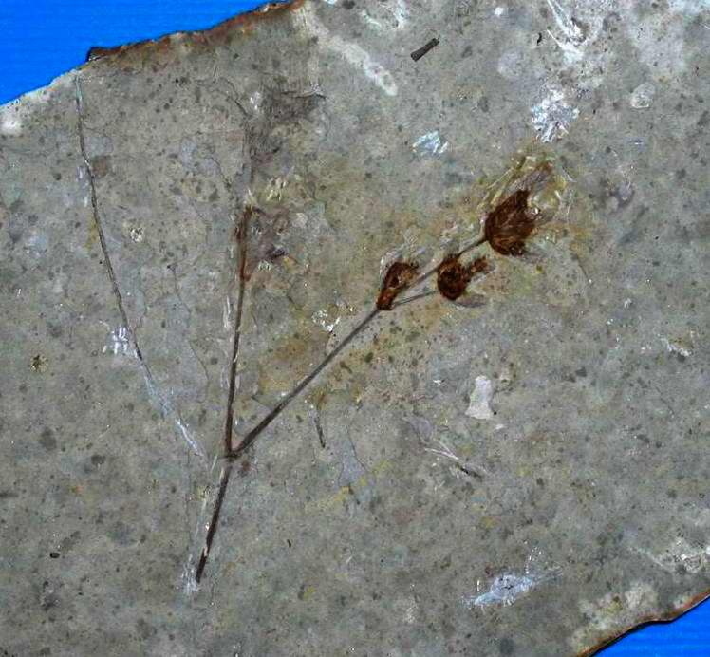
Late Jurassic-early Cretaceous
www.gtlsys.com/TradeShow/Booth/117/flower.JPG

Slide 22
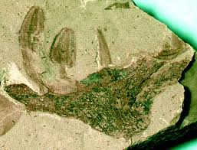
Florissantia quilchenensis – Malvaceae
www.washington.edu/burkemuseum/images
Lower Cretaceous (145-99 Mya)

Slide 23
Discordance
Fossil data:
lower Cretaceous – 130-140 Mya
pollen, Nymphaeales, Austrobaileyales
Molecular data:
lower Jurassic – 175-200 Mya
Triassic – 200-250 Mya
Paleozoic – 300-350 Mya

Slide 24
Conundrum
Congruence btwn FR and molecular phylograms regarding sequence and mode of early AG diversification
BUT
Disagreement btwn fossil and molecular estimates on crown AG age

Slide 25
Long Branches
Problematic
Combinations of substitution rates and time
Suspected to have biased MC estimates of AG origins
Exacerbated by lack of information regarding substitution rates and/or absolute times to guide molecular dating
Notes:
MC = molecular clock

Slide 26
Temporal constraints on LB
Living Gymnos distant relatives
Close AG relatives are extinct
Phylogenetic relationships among living AG unclear

Slide 27
This study
Used fossil AG relatives to break the long branch
Nt sequences of fossil relatives were simulated using a “phylogeny and model parameters from living taxa” incorporated into molecular dating
Will breaking the long branch yield a more reliable dating of AG origin (congruent w/ FR?)

Slide 28
Does long AG BL misguide MCs?
Question addressed by:
Breaking LB by including AG stem lineage relatives
Using different relaxed clocks to estimate ages across the tree
Focus on AG crown node
Notes:
BL = branch length
MC = Molecular clock

Slide 29
Approach
70 species, 69 genera
4 plastid genes
Increasing taxonomic sample to break LB
Bayesian analysis
Branch lengths postulated by multiple means (pg. 386)
Sequences of AG stem relatives simulated (pg. 386), introduced into 4 different RC analyses
Notes:
RC = relaxed clock

Slide 30
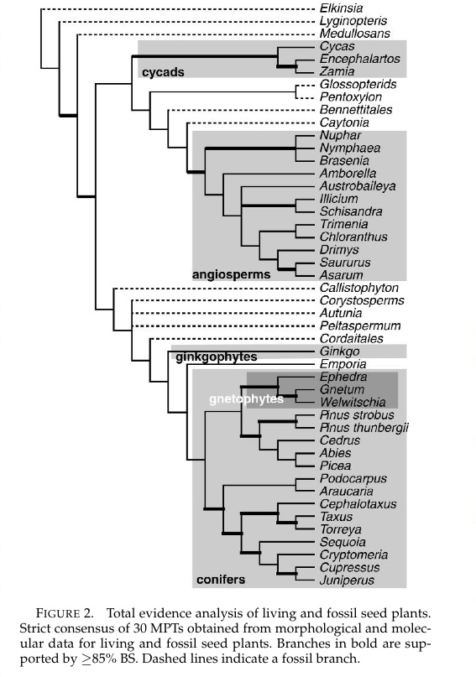
Notes:
MPT = most parsimonious tree

Slide 31
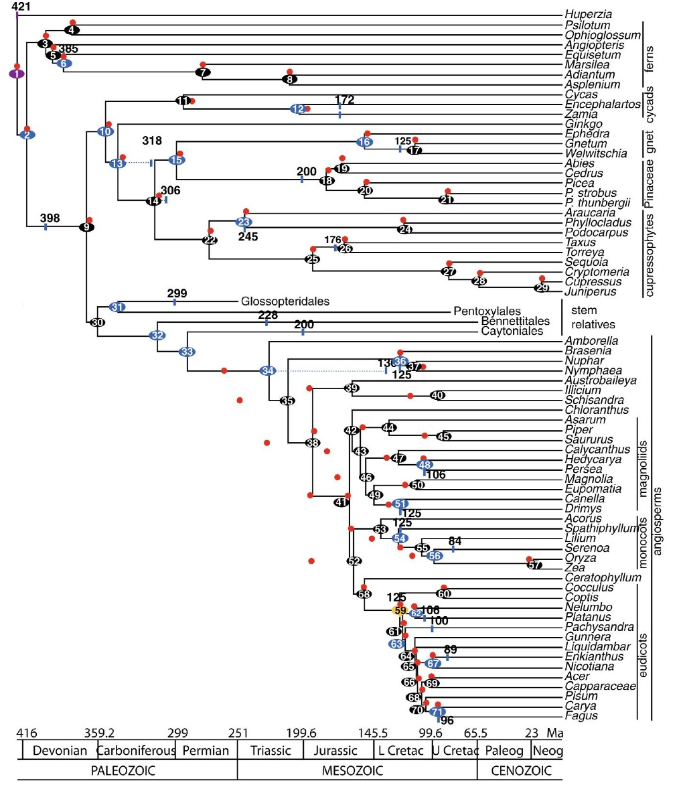

Slide 32
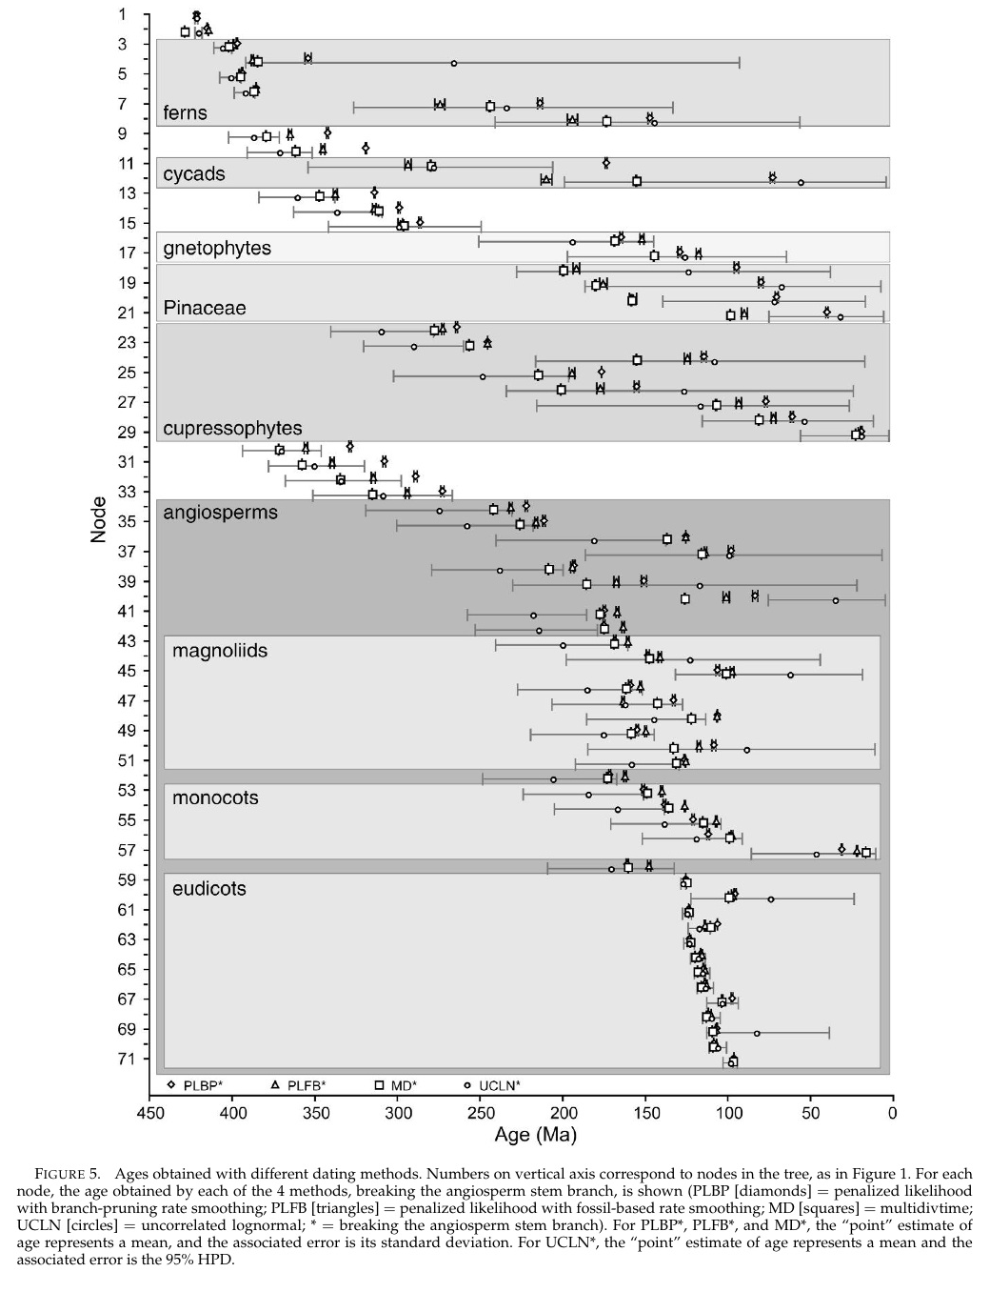
Notes:
Except for UCLN and UCLN* methods, associated errors around the mean age of most nodes are narrow.
Widest errors found in ferns, Pinaceae, and cycads; narrowest errors in within core eudicots.

Slide 33
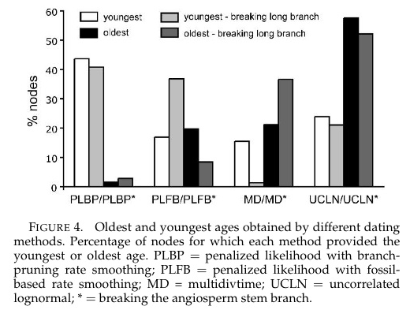
Notes:
PLPB and PLBP* tended to provide the youngest ages across the tree

Slide 34
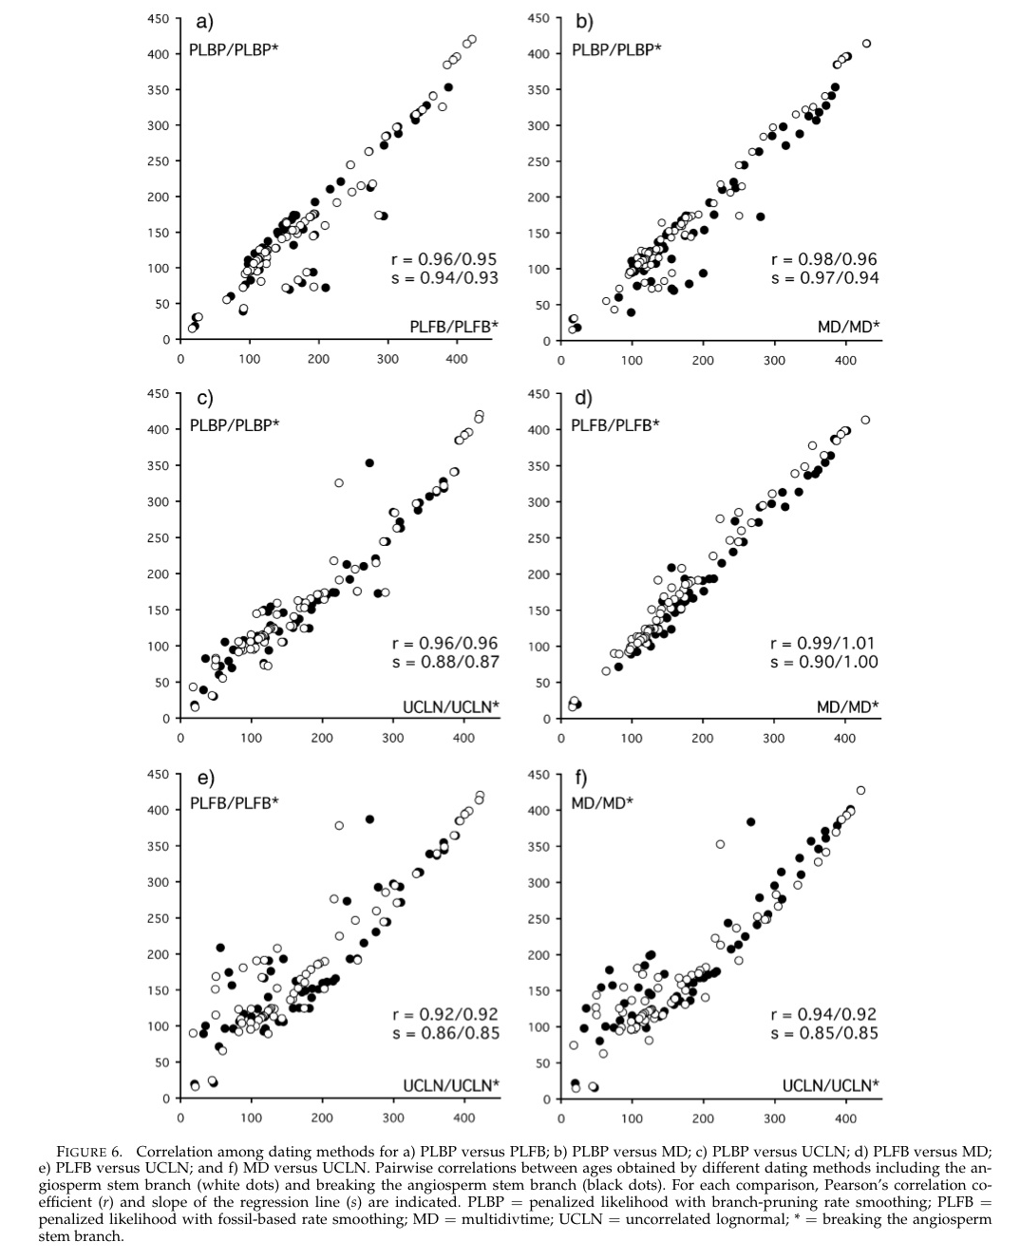

Slide 35
Conclusions
Only 1 of 4 dating methods resulted in younger age of AG crown
Hypothesis not supported:
Long AG stem branch causally responsible for prior molecular estimates of crown AG age, or discrepancy btwn fossil record and molecular data.
AG crown node sensitive to different relaxed clocks: 60 Myr difference btwn oldest and youngest (early Permian – upper Triassic)
Notes:
These estimates still older than the oldest AG fossils

Slide 36
Difficulty in aging crown AG
Large amount of extinct historical diversity
Rapid radiations
Possible substantial rate heterogeneity among lineages thru time

Slide 37
“How exactly paleobiology can inform about molecular rates is an open question.”

